Slide 1
Theory of Elasticity in Geotechnical Engineering
Lecture
Hadush Seged (Dr.)
January 26, 2010

Slide 2




2. FLAMANT'S PROBLEM
In this problem, instead of a point-load a line load acting on the surface of a half-space is considered as shown in Figure 9.1.
The line load is similar to the point load in that we have a finite force acting on a surface of zero area, but now the load acts on an infinitely long line rather than on a point.
Line load, P
The line load is represented by P and has dimensions of force per unit length.
FIG. 9.1: Flamant’s problem.

Slide 3
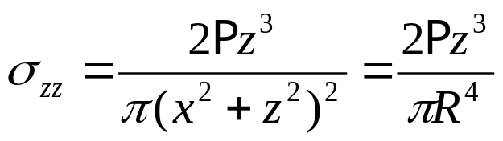


This problem was solved by another French engineer Alfred Flamant. Flamant was a colleague of Boussinesq and both were students of Saint- Venant.
Flamant used Boussinesq’s solution together with the principle of superposition to solve for the stress field at a point in the half-space. He considered the line load as sequence of point loads side by side.
Flamant’s solutions for the stress field at point A due to the line load P are:
P/unit length
...(9.1)

Slide 4
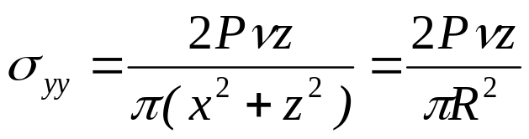
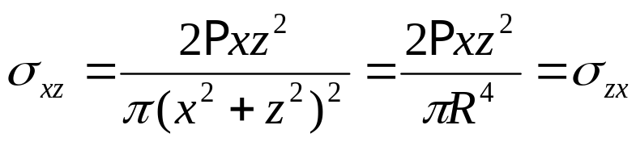

...(9.2)
...(9.3)
...(9.4)
Flamant’s solution is considered as one of many applications of Boussinesq’s solution.

Slide 5




3. KELVIN'S PROBLEM
This is a problem of a point load acting in the interior of an infinite elastic body.
This problem was solved by the Scottish physicist William Thompson (who later became Lord Kelvin) in 1848.
Infinite elastic body
Rather than P, let the magnitude of the load be 2P. This will help later when we compare Kelvin’s and Boussinesq’s solutions.
FIG. 9.2: Kelvin’s problem.

Slide 6
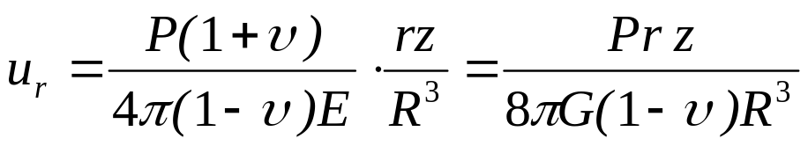




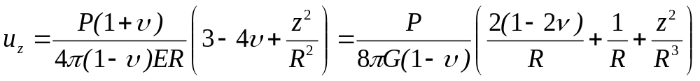
Kelvin found the following solutions, written in cylindrical coordinates:
...(9.5)
...(9.6)
...(9.7)

Slide 7
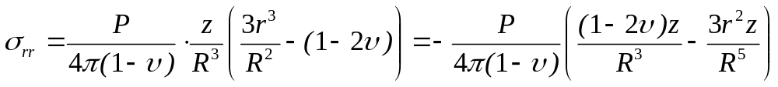
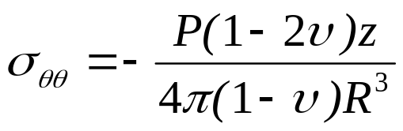
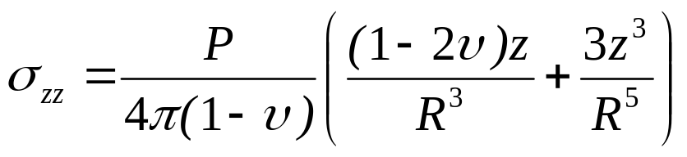

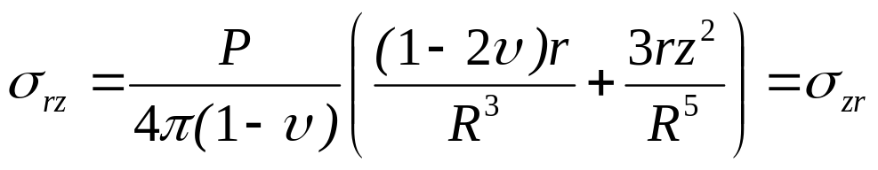

and:
...(9.8)
...(9.9)
...(9.10)
...(9.11)
...(9.12)

Slide 8
If we examine Kelvin’s solutions we observe:
singularities at the origin where the point load acts
both displacements and stresses vanish for large R.
on the plane z = 0, all of the stress components, except for σ_{rz} vanish, at all points except at the origin.
For the special case where ν = ½ (an incompressible material), σ_{rz} will also be zero on the plane z = 0 and the part of the body below the z = 0 plane becomes equivalent to the half-space of Boussinesq’s problem.

Slide 9


Comparing Kelvin’s solution (with ν = ½) and Boussinesq’s solution (with ν = ½), they are identical for all For we also have Boussinesq’s solution, with a negative load –P.
The two half-spaces, which together comprise the infinite body of Kelvin’s problem, act as if they are uncoupled on the plane z = 0 where they meet. We find two Boussinesq’s problems wedded on the surface z = 0.

Slide 10
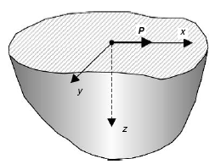
4. CERRUTTI'S PROBLEM
In 1882, the Italian, V. Cerrutti, solved the problem of a horizontal point load acting at the surface of an elastic half-space.
Boussinesq also solved this problem, but did so after Cerrutti without knowledge of Cerrutti’s solution.
Elastic half-space
The point load is represented by P and acts at the origin, pointing in the x direction.
FIG. 9.3: Cerrutti’s problem: tangential force on the surface of a half space.

Slide 11

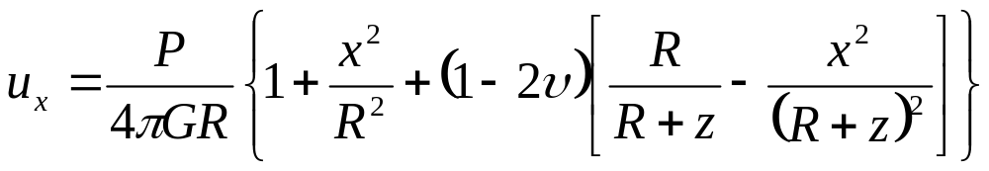

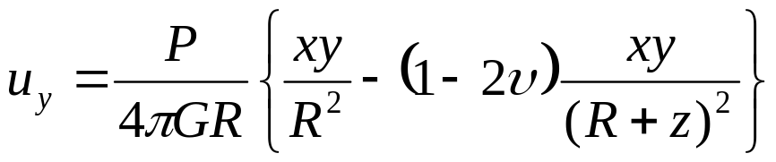
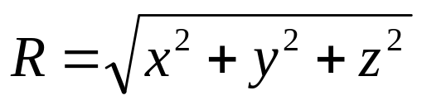
This is a more complicated problem than either Boussinesq’s or Kelvin’s problem due to the absence of radial symmetry enjoyed by those two problems. Here, rectangular coordinate system is used.
Cerrutti’s solution is:
...(9.13)
...(9.14)

Slide 12
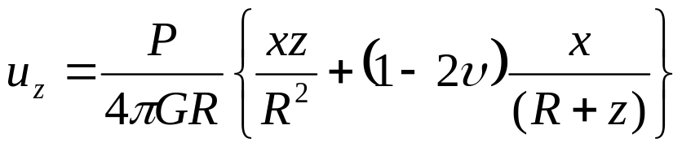
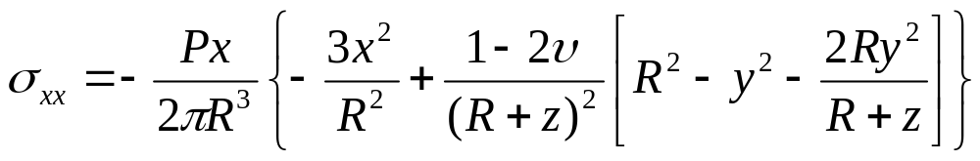
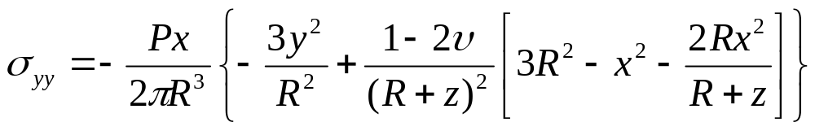
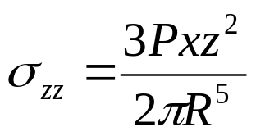
...(9.15)
and:
...(9.16)
...(9.17)
...(9.18)

Slide 13
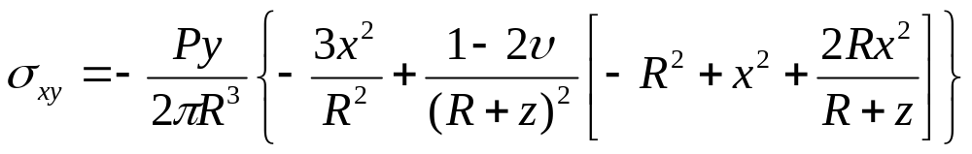
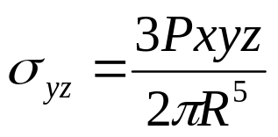
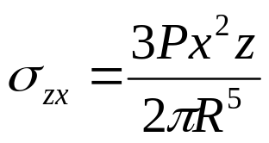
...(9.19)
...(9.20)
...(9.21)
Examining Cerrutti’s solution we find the expected singular displacements and stresses at the origin, while for large R, everything approaches zero.

Slide 14
Cerrutti’s solution is embedded in Kelvin’s solution for the special case of ν = ½. If we set ν = ½ in both solutions we find that the stresses and displacements in the left or right hand half-space of Kelvin’s problem are identical to Cerrutti’s solution, provided we designate the coordinate axes properly.

Slide 15






5. MINDLIN'S PROBLEM
The final two variations of the point-load problem were solved by Raymond Mindlin in 1936. These are the problems of a point load (either vertical or horizontal) acting in the interior of an elastic half-space.
Origin of coordinates
Mindlin’s problem is illustrated in Figure 9.4. The point load acts at a point located a distance z beneath the half-space.
Free surface
This problem is more complex than the other point-load problems.
FIG. 9.4: Mindlin’s problem

Slide 16
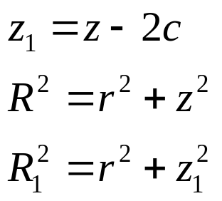
It has found application in considerations of the stress and displacement fields surrounding an axially loaded pile and study of interaction between foundations and grout anchors.
In writing out Mindlin’s solution the origin of coordinates is placed at a distance c above the free surface. Then, the applied load acts at the point z = 2c. We also have:
...(9.22)
z₁ and R₁ are the vertical distance and the radial distance from the point load.

Slide 17
For the case of a vertical point load, Mindlin’s solution is most conveniently stated in terms of Boussinesq’s solution.
Consider for a moment the displacement and stress fields in Boussinesq’s solution in the region of the half-space below the surface z = c. This stresses and displacements are also found in Mindlin’s solution but with additional terms.
The additional terms are given below and to obtain the complete solution we must add them to equations (8.8) to (8.10).

Slide 18
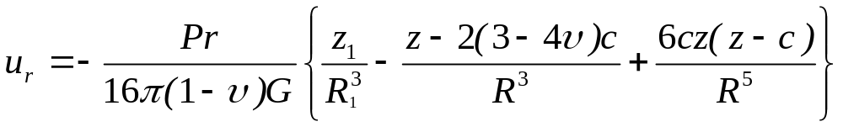
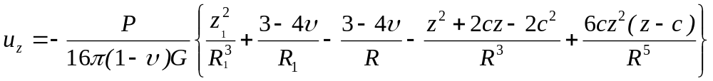
...(9.23)
...(9.24)
...(9.25)
and:

Slide 19
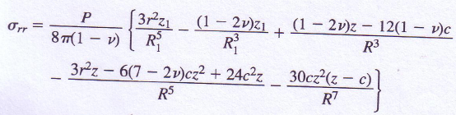
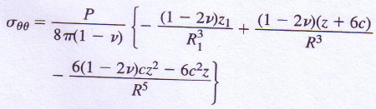
...(9.26)
...(9.27)

Slide 20
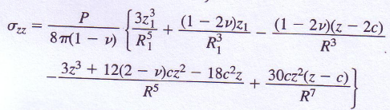
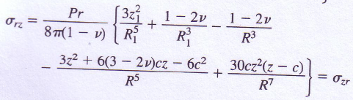

...(9.28)
...(9.29)
...(9.30)

Slide 21
Mindlin’s solution for a horizontal point load also employs the definitions for z₁ and R₁, but now we must introduce rectangular coordinates because there is no longer cylindrical symmetry.
r² should be replaced by x² + y², and assume that the load acts in the x-direction at the point z = c.
The solution here is conveniently stated in terms of Cerrutti’s solution, as the vertical load was given in terms of Boussinesq’s solution. Thus, the displacements and stresses to be added on Cerrutti’s solution are given below.

Slide 22
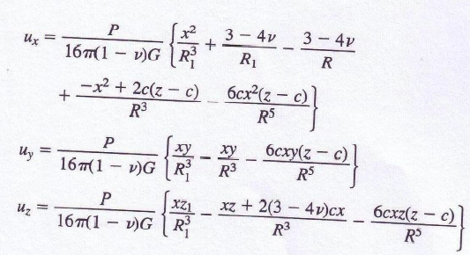
...(9.31)
...(9.32)
...(9.33)

Slide 23
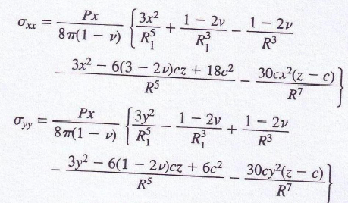
...(9.34)
...(9.35)

Slide 24
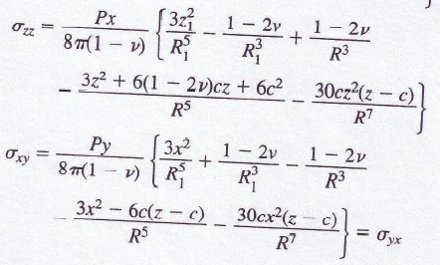
and:
...(9.35)
...(9.36)

Slide 25
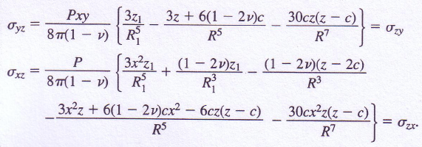
...(9.37)
...(9.38)

Slide 26
Now consider the solution for the vertical load in Equations (9.23 to 9.25) and (9.26 to 9.30… See slide 18~). If the distance c approaches infinity, then Kelvin's solution (slide 5~) for the infinite body is obtained.
We can see that c approaches infinity implies both z and R become infinite, and all terms that involve z and R disappear. Those terms that are left involve z_{l} and R₁, but we realize z_{l} and R₁ in Mindlin’s solution are exactly the same as z and R in Kelvin's solution.

Slide 27
Note that Eqns. (9.23 to 9.30) must be added to Boussinesq's solution to give the complete displacement and stress fields for Mindlin's problem, but, with R→∞ all Boussinesq’s terms reduce to zero.
Finally, remember that Kelvin's problem involved a point load of 2P, while Mindlin's solution represents a point load P. Keeping these points in mind, Eqns. (9.23 to 9.25) and (9.26 to 9.30) will reduce to Kelvin's solution when c → ∞.
Exactly the same conclusion applies to Mindlin's second problem, but the x and z axes must be interchanged and cylindrical coordinate used in Eqns. (9.31 to 9.33) and (9.34 to 9.38).

Slide 28
If c = 0 (and consequently z_{l} = z, R₁ = R), all of the displacements and stresses vanish. This is expected, since Mindlin's problem with c = 0 is equivalent to Boussinesq's problem, and Eqns. (9.23 to 9.30) are the differences from Boussinesq's solution.
A similar conclusion applies to (9.31 to 9.33) and (9.34 to 9.38) with c = 0, taking account of Cerrutti's solution.
Therefore, Mindlin's solutions properly correspond to Boussinesq's and Cerrutti's solutions for the special case of c = 0.

Slide 29


OTHER FUNDAMENTAL SOLUTIONS
There are other point load problems and their solutions. These problems are generally not of such great interest in geotechnical engineering but they may be useful in special circumstances.
One of these additional problems is the case of an elastic layer resting on an elastic half-space with different
elastic properties.
Elastic layer
FIG. 9.5: Point load on elastic layer
Elastic half-space

Slide 30
This problem has two categories:
Smooth interface between the layer and the half-space implying different horizontal displacements above and below the interface.
Rough interface between the layer and the half-space implying same horizontal displacements in both materials.
This problem with rough interface was first solved by Donald Burmister in 1943 for the special case of incompressible materials (ν = ½). He later extended his solution for compressible materials and multiple layers.

Slide 31
Unfortunately, Birmister’s solutions are complex and difficult to apply. In stead other simple approximate solutions for layered soils are used.
A second category of problems involves dynamic loads. In this problems the load is a function of time.
The simplest problem is a dynamic point load acting in the interior of an infinite elastic body, the dynamic analogy of Kelvin’s problem. This problem was solved by the Irish mathematician George Stokes in 1849, one year after Kelvin has solved the static problem.

Slide 32
Another dynamic problem, which is the dynamic equivalent of Flamant’s problem with a dynamic line load on the surface of an elastic half-space has been solved by Horace Lamb in 1904.
A third group of point-load problems are those involving anisotropic or continuously non-homogeneous elastic half-spaces.
The solution of a normal point load on the boundary of an anisotropic elastic half-space was determined by the Australian J. H. Michell in 1990. Michell considered a particular type of anisotropy called transverse isotropy – where the elastic properties of the body are the same in the horizontal x, and y directions but different in the vertical z direction.

Slide 33
Problems involving non-homogeneous elastic bodies were also solved by another Australian, John Booker and his two co-workers in 1985.
These solutions apply specifically to elastic materials in which the value of the Young’s modulus E increases with increasing depth beneath the free surface, while Poisson’s ratio ν remains constant. Both point load and line load solutions were obtained.
In summary, looking back over the array of fundamental solutions, Boussinesq’s solution is the most useful to the geotechnical engineer. It has the virtue of simplicity. More over, the two most important stress components σ_{zz} and σ_{rz}, have solutions that do not depend on either of the elastic constants.

Slide 34
Following the publications of Boussinesq’s solution, engineers throughout the world began to use it but most importantly it was an easy matter to integrate Boussinesq’s solution over some regions of the half space to obtain a solution for a distributed pressure.
The simplest loaded region to integrate was circular, and the σ_{zz} distribution in an elastic half-space subjected to a uniform circular load became well known.
Experiments were performed and comparisons between measured and computed values of stress showed considerable differences.

Slide 35
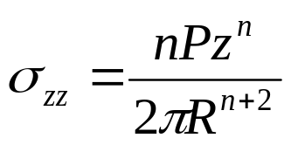
The differences resulted from two experimental difficulties:
the inability to apply a uniform stress over circular region.
and the use of a thin layer of soil to represent a half-space.
Unfortunately, the differences were interpreted as a failure of Boussinesq’s theory, and investigators set out to adjust the Boussinesq’s equations. This was done by replacing the solution for σ_{zz} by the following equation:
...(9.39)

Slide 36
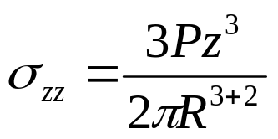
Comparing with eqn. (9.39), Boussinesq’s result corresponds to the case where n = 3.
The parameter n was called the concentration factor, and a great deal of interest was focused on what value it should have for different soil conditions. This approach was fundamentally wrong.
A material governed by eqn. (9.39) is inelastic for any value of n except 3. For inelastic body, the principle of superposition is inapplicable, hence integrating over a distributed load has no basis.

Slide 37
Never the less, the idea of the concentration factor held on for many years.
“No one believes the theoretician except the theoretician himself. Everyone believes the experimentalist except the experimentalist himself.”

Slide 38

GRAVITY STRESSES, STRESS FUNCTIONS
The stress states in a soil deposit caused by the self weight of the soil are called gravity stresses.
Consider a soil deposit with a horizontal surface and possibly (horizontal layering as shown the figure below).
Traction free surface
FIG. 9.6: Gravity stress: horizontal ground surface.

Slide 39
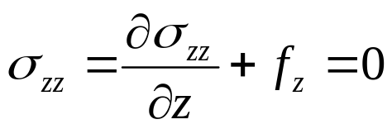
For this condition, σ_{xx} = σ_{yy} and the shear stresses σ_{xy}, σ_{yz}, and σ_{xz} will all be zero. Moreover, non of the stresses should be a function of x or y.
The equilibrium equations (5.19…lecture 5) are identically satisfied except for the third equation, which reduces to:
...(9.40)
The body force f_{z} = –ρgz, taking compressive stress negative. Here ρ is soil mass density, and g acceleration of gravity. Integrating eqn. (9.40), we have:

Slide 40
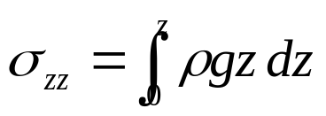
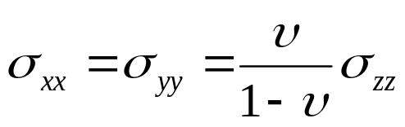
...(9.40)
For a homogeneous soil, σ_{zz} = ρgz.
What will be the horizontal stresses σ_{xx} and σ_{yy}? There is no short and clear answer for this question.
If the soil is perfectly elastic, the horizontal deformations in the half-space will be zero. Setting ε_{xx} and ε_{yy} equal to zero in Hooke’s law (see eqn. 6.5…lecture 6), we find:
...(9.41)

Slide 41
But this result depends on the assumption of elastic behavior.
Irreversible volumetric strains may occur in natural deposits, leading to the concept of normally consolidated and over-consolidated soils. Irreversible strains will result in inelastic behavior, and Hooke’s law with the assumption of zero horizontal displacement can no longer be used.
Careful horizontal stress measurements made by geotechnical engineers on natural deposits have shown that the values of σ_{xx} and σ_{yy} widely vary depending on the past history of the soil.

Slide 42
In normally consolidated soils σ_{xx} and σ_{yy} will be smaller than σ_{zz}, and equation (9.41) may give reasonably good approximation for their value.
In over-consolidated soils, however, σ_{xx} and σ_{yy} will usually be greater than σ_{zz} that can not be achieved using eqn. (9.41) because ν can not exceed ½.
We see that the question of what the gravity stresses are is not a simple one. Some measurements in certain soil deposits suggest that σ_{xx} and σ_{yy} may take significantly different values themselves.

